Slide 1


A wind tunnel for kids…
…where pigs can fly
Status Update
April 12, 2012

Slide 2
Activities this week
Virtual tunnel development
Tablet analysis of alternatives
Added two-way communication via JSON
Added integration test code to emulate Arduino
Removed DrawShape methods
Obtained five new computation meshs
UI tweaks
Physical tunnel development
New parts arrived
Requirements Evaluation

Slide 3
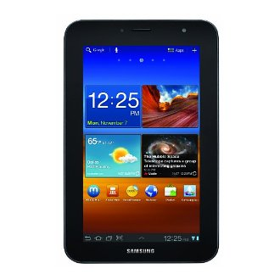
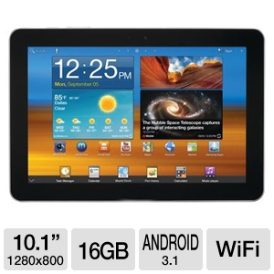
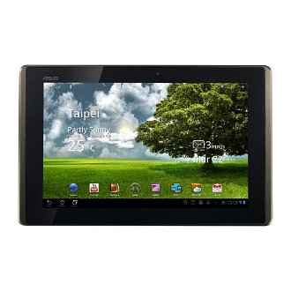
Tablet AoA Evaluation
Option # 1
Samsung Galaxy Tab 7.0 Plus 16GB (Dual Core, Universal Remote, WiFi)
$419
Option # 2
Samsung GT-P7510-MA16ARB Galaxy Tab 10.1" WiFi Android Tablet - Android 3.1 Honeycomb, NVIDIA Dual-Core Tegra 2, 10.1" WXGA, 1GB Memory, 16GB Storage
$339
Option # 3
ASUS Transformer TF101-A1 10.1-Inch Tablet
$359

Slide 4
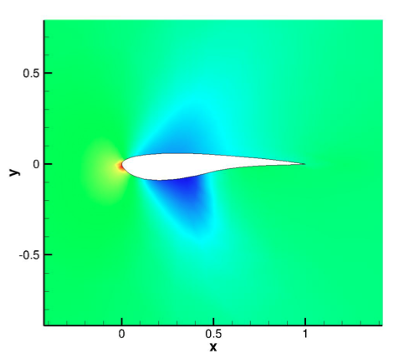
New Computational Mesh
Mesh courtesy of Tunnel-K consultant, Dr. James S. Masters, Aerodynamicist
Realistic wing shape

Slide 5
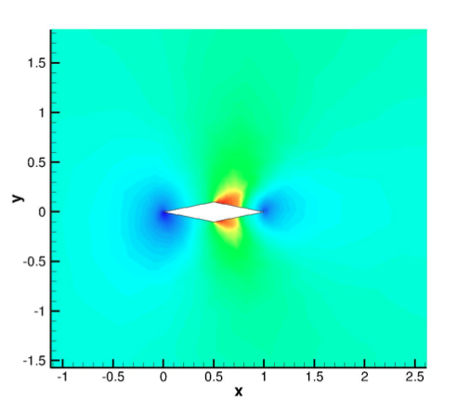
New Computational Mesh
Mesh courtesy of Tunnel-K consultant, Dr. James S. Masters, Aerodynamicist
Diamond

Slide 6
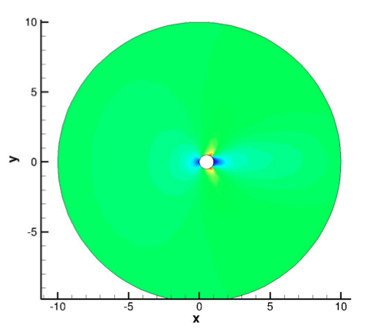
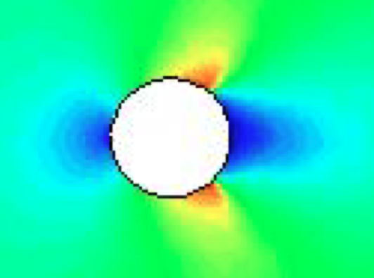
New Computational Mesh
Mesh courtesy of Tunnel-K consultant, Dr. James S. Masters, Aerodynamicist
Circle

Slide 7
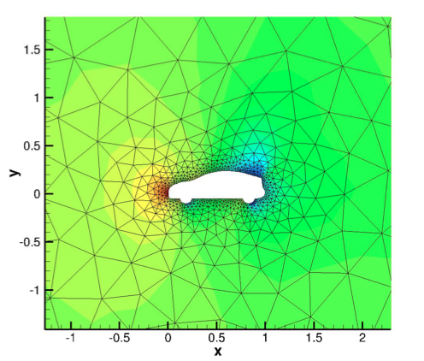
New Computational Mesh
Mesh courtesy of Tunnel-K consultant, Dr. James S. Masters, Aerodynamicist
Flying car

Slide 8
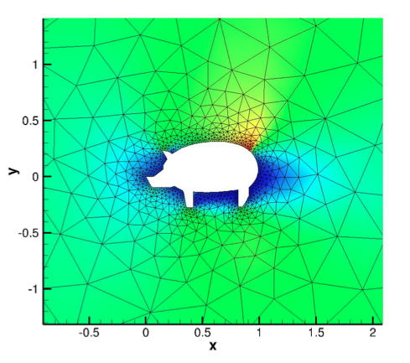
New Computational Mesh
Mesh courtesy of Tunnel-K consultant, Dr. James S. Masters, Aerodynamicist
Flying bacon

Slide 9
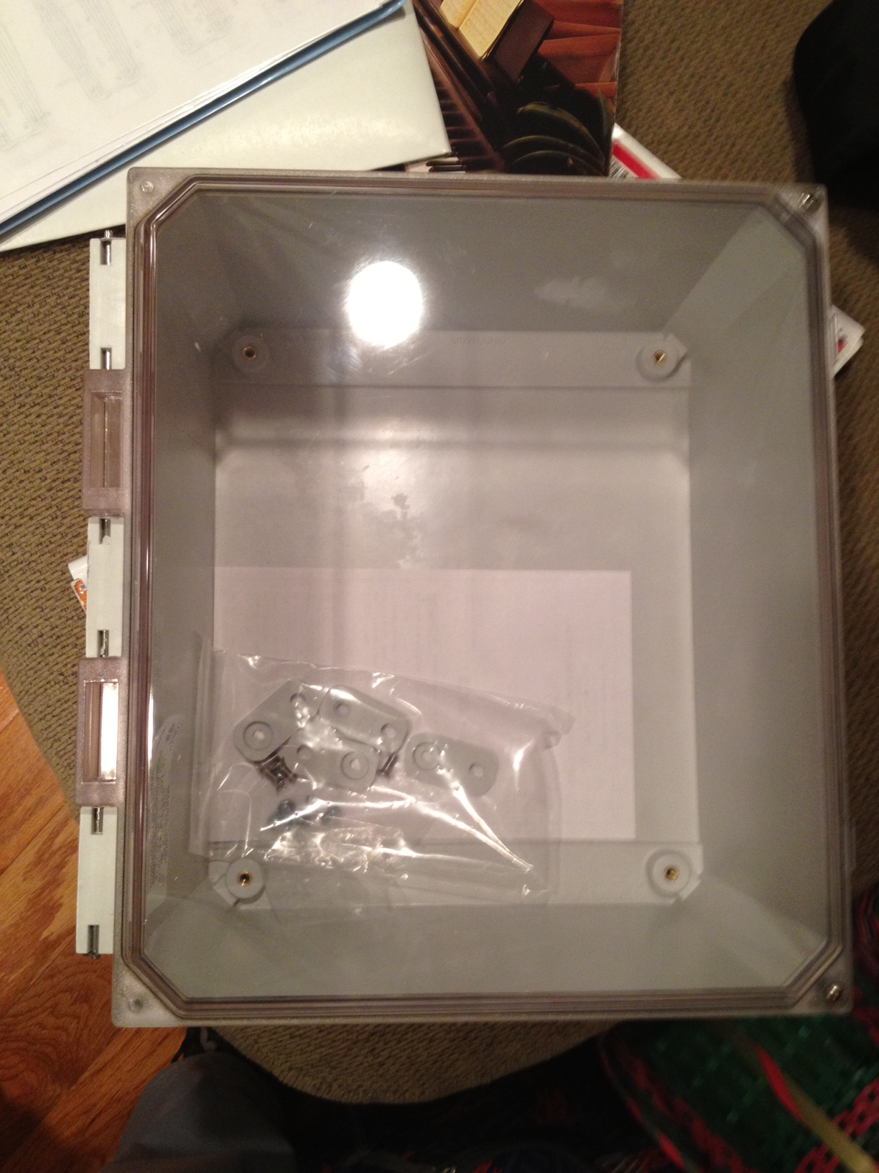
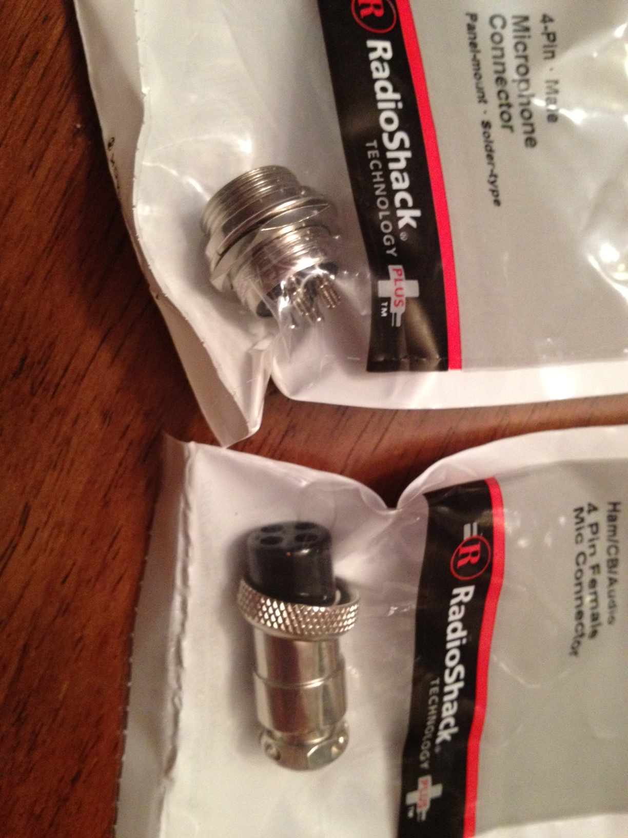
New Parts for Physical Tunnel
Connectors
Box where Arduino micro-controller will go

Slide 10
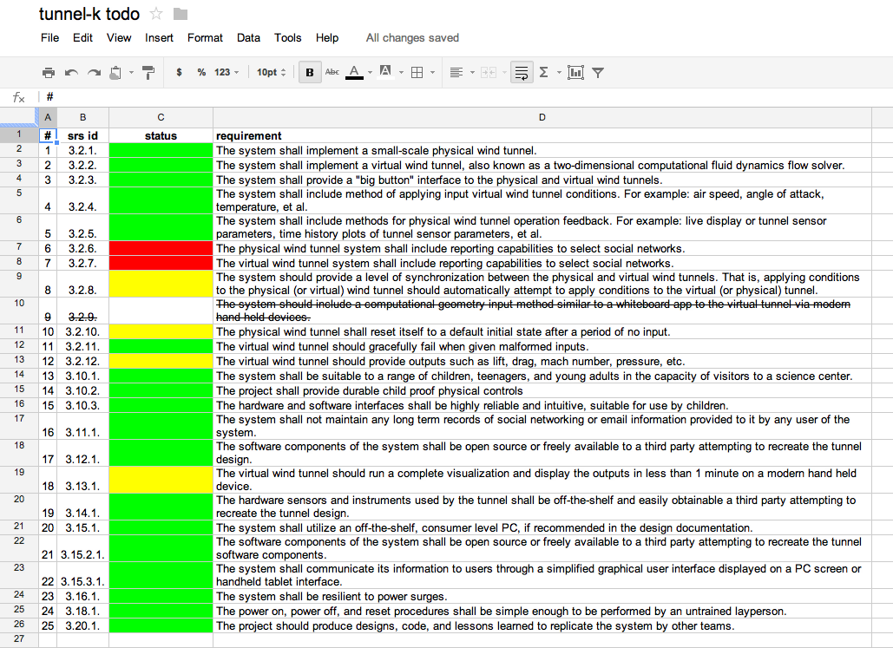
Status of Requirements
19 of 24 requirements completed
4 of last 6 requirements have started
2 requirements not yet started
Details @ http://goo.gl/ipJjU

Slide 11
Baseline Documentation Metrics
Metric | Value | Notes
# Developer Documents | 116 | SoW, SDP, SRS, SDD, Fall FQT, Javadocs
# Administrator Documents | 0
# Pages | 158
# Status Presentation Slides | 149

Slide 12
Baseline Code Metrics
Metric | Value | Notes
SLOC (Physical) | 9325
SLOC (Logical) | 8158
# Source Files | 131 | File types included: .h, .cpp, .java, .xml, .pde, .ino

Slide 13

Baseline Hardware Metrics
Metric | Value | Notes
# Sensors Prototyped | 3 | Temperature, Humidity, Hall Effect
# Control Elements Prototyped | 2 | Motor Control, LED
# Sensors Integrated | 3 | Temperature, Humidity, Hall Effect
# Control Elements Integrated | 2 | Motor Control, LED

Slide 14
You’re Invited!
Who: Dr. Kulick, Tullahoma Hands on Science Center customers, Tunnel-K Development Team, and all CPE 658 participants
What: Tunnel-K Final Qualification Test
When: 2pm CDT, Friday, April 27, 2012
Where: Tullahoma Hands on Science Center, 101 Mitchell Blvd, Tullahoma, TN 37388

Slide 15
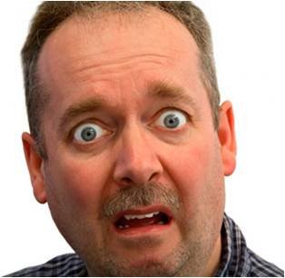

Follow us on Twitter… 9 followers – 49 tweets
@TunnelK
Notes:
Initial social network of choice…

